Slide 1
Scaling OpenStack Private Clouds
Using Cells v2
Chris Breu – Senior Cloud Architect
James Denton – Principal Architect

Slide 2
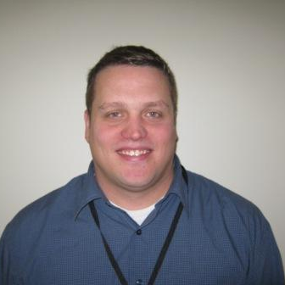
Introductions
Chris Breu
Senior Cloud Architect
Email: chris.breu@rackspace.com
James Denton
Principal Architect
Email: james.denton@rackspace.com
IRC: jamesdenton
Twitter: @jimmdenton

Slide 3
Help! My cloud has fallen and can’t get up!
Challenge Build a cloud that supports up to 5,000 compute nodes with a single endpoint.
Solution Deploy OpenStack with OpenStack-Ansible using Nova Cells v2.
Achievement With the current Cells v2 implementation, Rackspace is supporting over 3,600 compute nodes across 14 cells behind a single API endpoint, with plans to increase up to 5,000.
“OpenStack is awesome!”
Emmet, Cloud Architect, Lego Universe

Slide 4
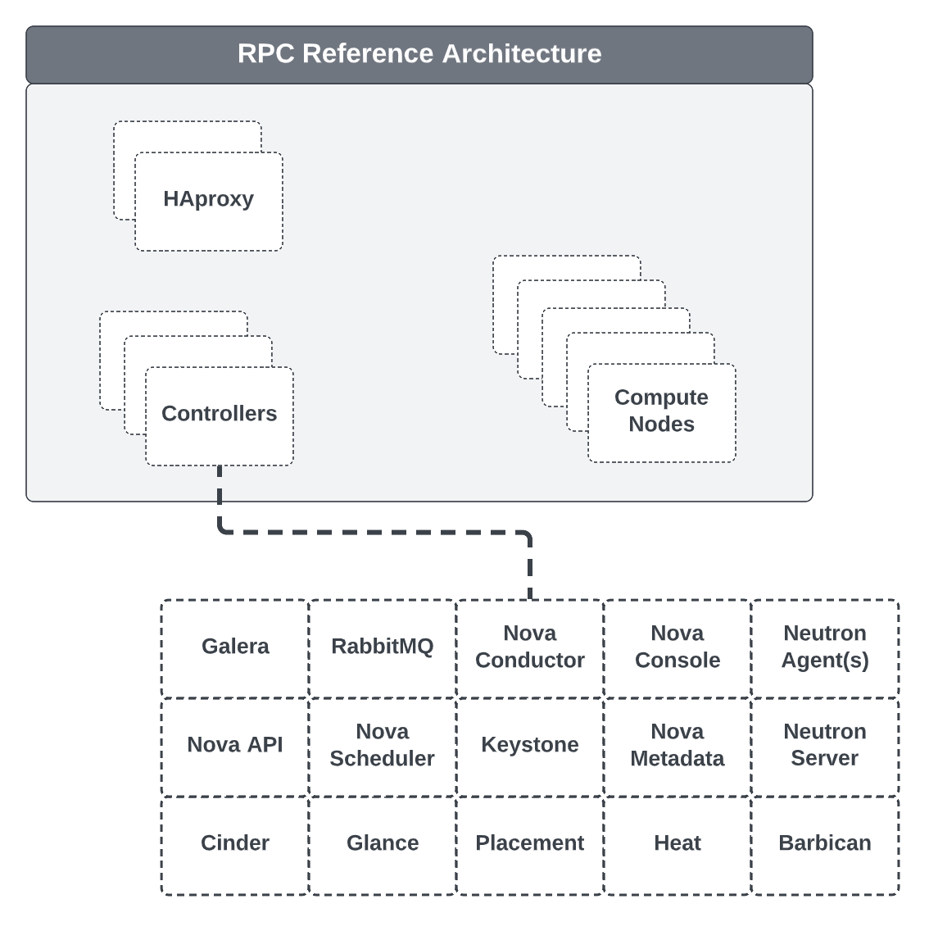
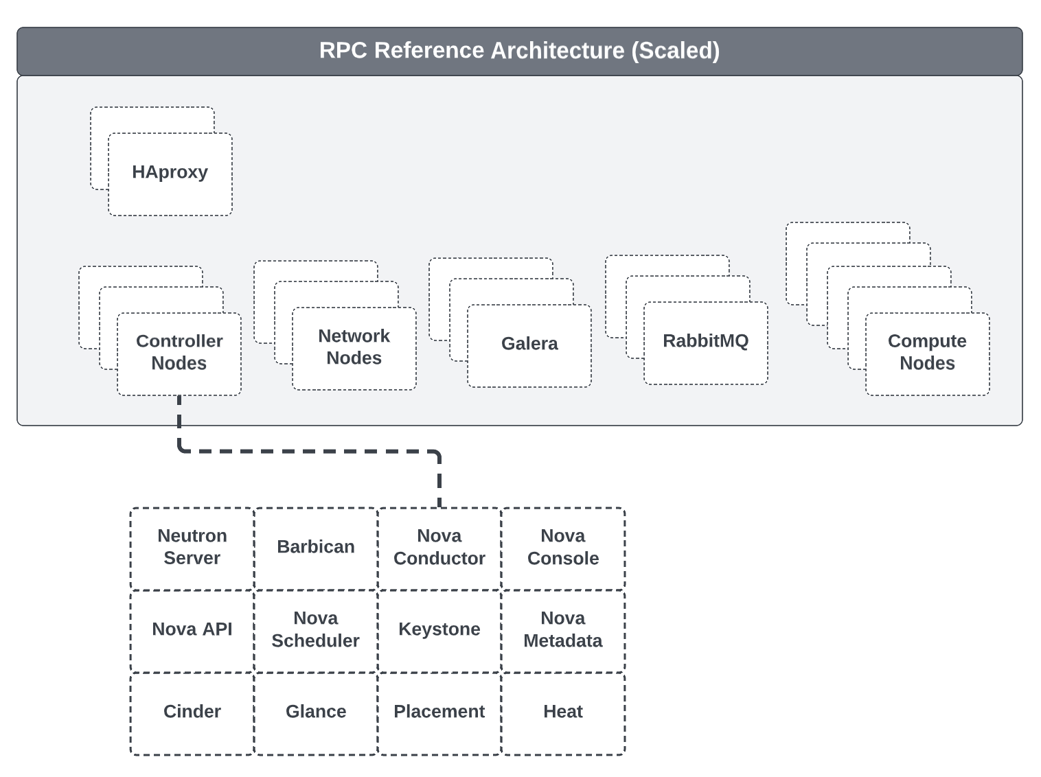
Reference Architecture

Slide 5
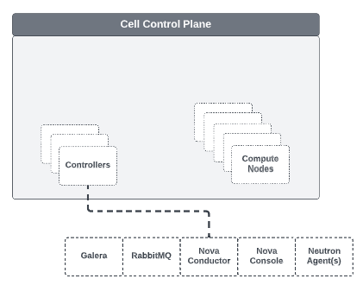
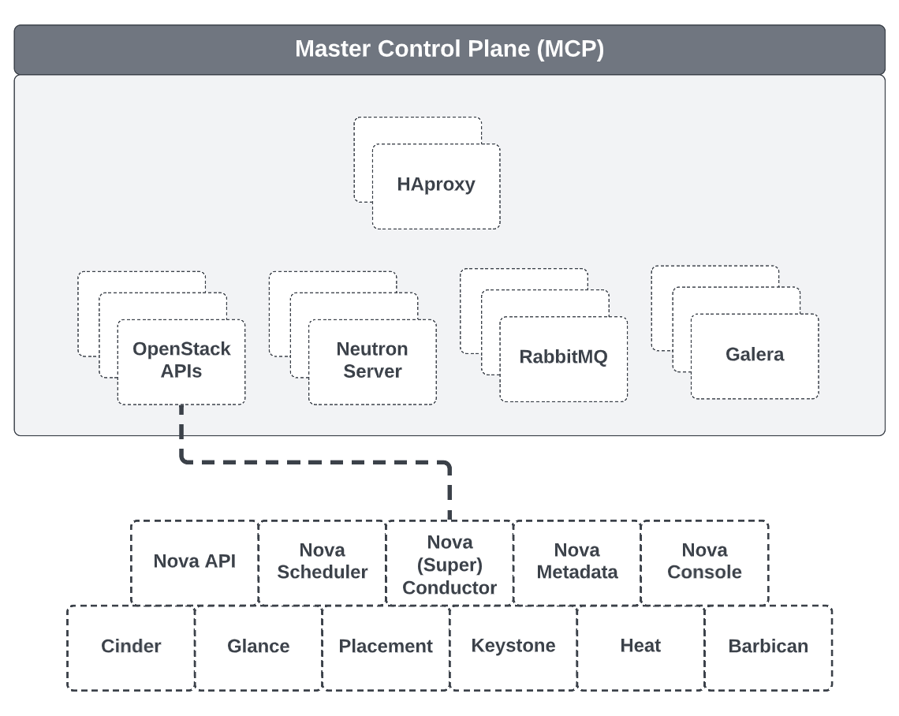
Proposed Architecture (Cells v2)

Slide 6
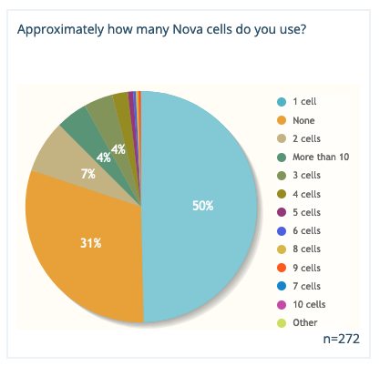
Cell Usage
As of the 2021 OpenStack User Survey, 11 deployments were marked as utilizing more than 10 cells.
11

Slide 7
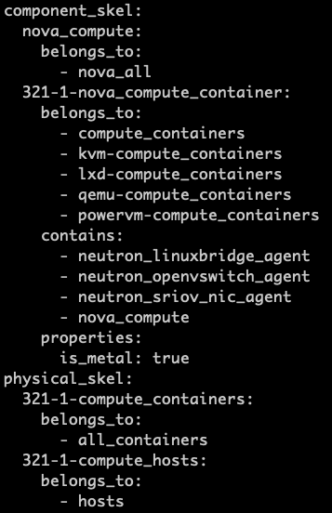
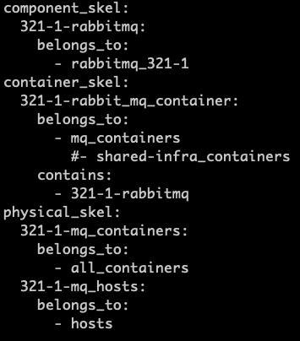
Deployment
OpenStack-Ansible - https://docs.openstack.org/openstack-ansible/latest/
Using OpenStack-Ansible, changes can be made to the following to support Cells v2:
Host Groups (conf.d)
Container Groups (env.d)
HAproxy (Additional Services)
Playbooks (Extra Vars)
Cell Mappings

Slide 8
Considerations
When planning for Cells v2, there may be design considerations.
Galera
Centralized Keystone Management
> 35K Concurrent Connections
Keystone
RabbitMQ
> 15K Concurrent Connections
Glance
Neutron
Routed Provider Networks
Common Glance Experience

Slide 9
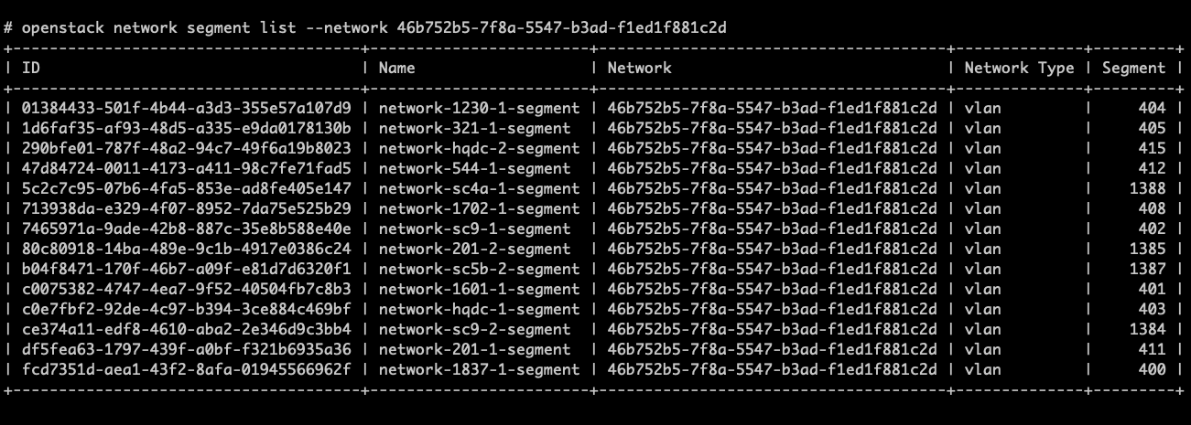
Routed Provider Networks w/ Network Segments
Cell Name | Network Name | Subnet CIDR | Segment ID
CELL1 | PUBLICNET | 100.64.0.0/22 | 1001
CELL2 | PUBLICNET | 100.64.4.0/22 | 1002
CELL3 | PUBLICNET | 100.64.8.0/22 | 1003
CELL4 | PUBLICNET | 100.64.12.0/22 | 1004
Each cell is linked by a common Neutron DB in the MCP
Tenants spin up resources using a network name, and the CIDR and segment are chosen based on whichever cell it lands in.

Slide 10
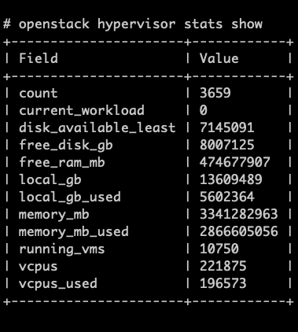
Final Thoughts
Upgrades
Issues
Alternatives

